Slide 1
Assessing for and Building a Resiliency Plan Against Compassion Fatigue
V. Paige Zeiger, M.S., LPC, NCC, BC-TMH, CCFP
CES Doctoral Candidate, Walden University
Dr. Yulanda Tyre, Ph.D., LPC-S
Professor, Liberty University
2020 ACCA Annual Conference
February 27-March 1, 2020
Washington, DC
Notes:
Hello ACCA attendees! Welcome and thank you for selecting our presentation to attend over the various other programs that you could have chosen.
I want to start off by introducing myself and my co-presenter, Dr. Yulanda Tyre.
My name is Paige Zeiger and I am currently a Counselor Education and Supervision doctoral candidate at Walden University, finishing up my dissertation with any expected graduation in May 2020. Yay! In addition, I am a LPC in the state of AL, Board Certified Telemental Health provider, Certified Clinical Trauma Professional, and Certified Compassion Fatigue Professional, and I must admit that my most favorite trainings were the Clinical Trauma and Compassion Fatigue because these are real issues that all mental health professionals struggle with whether they acknowledge it or not.
Now, I will turn the floor over to Dr. Yulanda Tyre to introduce herself.

Slide 2
Learning Objectives
1
2
3
Develop a clear understanding of what signs and symptoms demonstrate compassion fatigue, vicarious trauma, and burnout.
Exhibit the ability to skillfully administer and interpret compassion fatigue assessments, such as the ProQOL, and the competence to recognize key resiliency skills for the prevention of compassion fatigue.
Create an effective resiliency plan for addressing compassion fatigue, burnout, and vicarious trauma and demonstrate the ability to implement these new skills toward preventing compassion fatigue.
Notes:
As you can see we have three major objectives for today’s presentation. I want you to know that we are going to be exploring compassion, compassion satisfaction, compassion fatigue, and strategies to mitigate compassion fatigue signs and symptoms. When you leave here today, you will not only have a clear understanding of compassion fatigue and how to identify or recognize the signs and symptoms, but you will also walk out of today with a plan of action, or at least the start to one, that, like our own life-long learning processes, will continue to be ever-changing as we grow, mature, and become more competent as helping professionals.

Slide 3
What is Compassion Fatigue?
A state experienced by those helping people or animals in distress: it is an extreme state of tension and preoccupation with the suffering of those being helped to the degree that it can create a secondary traumatic stress for the helper.
Charles Figley, Father of Psychosocial Stress & Compassion Fatigue
J. Eric Gentry, Board Certified Expert in Traumatic Stress
“There is a cost to caring for others in emotional pain.” (Figley, 1995)
Notes:
Now, when we look at the opposite of compassion or compassion satisfaction, we are talking about compassion fatigue, burnout, vicarious trauma, secondary traumatic stress, or symptoms that look and feel very much like PTSD symptoms, if you were to refer to the DSM-5 manual.
Why is it important to be knowledgeable about compassion fatigue? Again, as a part of our ACA ethical principles and standards state as well as how to practice as ethical helping professionals: Do no harm, Increased self-awareness (competence), self-care
Compassion fatigue can cause us to become less empathetic over time. Our compassionate connection erodes and we close ourselves off, often as protection against further wounding.
We strive to be fully present for our clients, but this emotional involvement has consequences, particularly when the client is dealing with trauma.
Our empathy ends up wounding us and making us more vulnerable to caregiver stress. It can lead to over-identification with our clients who suffer.
Over-identification with a client or suffering may lead helpers to develop compassion fatigue that can look like:
• Form an unhealthy bond
• Focus exclusively on the client’s trauma
• Develop blurred boundaries
• Become enmeshed
• Try to rescue the client
• Advocate excessively for the client
Compassion Fatigue: Compassion Fatigue (CF) is when someone who regularly hears/witnesses very difficult and traumatic stories begins to lose their ability to feel empathy for their clients, loved ones and co-workers. This deep physical and emotional exhaustion has been described as “having nothing left to give” and “an occupational hazard”. Compassion Fatigue can show as a variety of symptoms presenting either behaviourally, emotionally, relationally, physically and spiritually. Sometimes CF is misdiagnosed as depression.(Richard, 2013)

Slide 4
Compassion Fatigue
The emotional residue or strain of exposure from working with those suffering from the consequences of traumatic events.
Also known as - But very different definitions….
Vicarious Trauma
Secondary Traumatic Stress
Burnout
(Figley,1995; Gentry, ___)
Notes:
Compassion Fatigue
Also called “vicarious traumatization” or secondary traumatization (Figley, 1995). The emotional residue or strain of exposure to working with those suffering from the consequences of traumatic events. It differs from burn-out, but can co-exist. Compassion Fatigue can occur due to exposure on one case or can be due to a “cumulative” level of trauma.
Burnout
Cumulative process marked by emotional exhaustion and withdrawal associated with increased workload and institutional stress, NOT trauma-related.
Primary Traumatic Stress
Primary stressors are those inherent in the extreme event, such as what was immediately experienced or witnessed, especially those things most contributing to a traumatic response.
The Stages of Burnout have been identified as:
enthusiasm
stagnation
frustration
apathy
Not only are caregivers vulnerable, but members of the team/family are as well. Caregivers/team members should not intentionally expose themselves to trauma, unless required to perform a mission.
Commonalitities of Burnout and Compassion Fatigue:
Emotional exhaustion
Reduced sense of personal accomplishment or meaning in work
Mental exhaustion
Decreased interactions with others (isolation)
Depersonalization (symptoms disconnected from real causes)
Physical exhaustion
Clear difference: Compassion fatigue has a more rapid onset while burnout emerges over time. Compassion Fatigue has a faster recovery (less severe, if recognized and managed early). American Institute of Stress, 2019
Compassion Fatigue is developed because of the helper’s strong ability to care for their clients in the first place. It is the most caring individuals who are most likely to develop CF. The best helping professionals are able to connect with their clients because of their strong ability to empathize with them. It is this gift of empathy that can also lead them to develop CF. By learning about CF and developing ways to manage it, these helpers can continue to do the work they love, and are good at, while still being able to thrive personally. Simply leaving one helping job and moving into another will not reduce one’s CF.
Vicarious Trauma: When a person is continuously exposed to other people’s traumatic experiences through witnessing and/or hearing others’ stories, vicarious trauma can be experienced. Vicarious trauma (VT) means that you have not been the direct victim of a trauma, but you have experienced it second hand through your client’s stories and may be experiencing post traumatic stress symptoms similar to the person who experienced it. This can include intrusive imagery (images of trauma popping into your head) dreaming about the traumatic situation or avoiding certain activities and so on.
Ongoing vicarious trauma can result in a shift in the helper’s world view and sense of meaning, for example, someone who may regularly feel safe can begin to doubt their safety if they work with victims of crime and hear numerous stories of crimes and trauma. If a helper has a previous history of trauma (and many have as more than 70% of the population has experienced one or more event significant enough to be traumatic) that is unresolved, then you are more likely to experience VT.
Burnout: Burnout is the extreme end of Compassion Fatigue. Both compassion fatigue and vicarious trauma can lead to burnout. It means that symptoms have been happening on a regular basis for a long time and longer term support will likely be necessary to recover.
In extreme cases, burnout can lead to serious physical and mental illness. (Richard, 2013)

Slide 5
“Caregivers who suffer from compassion fatigue may actually justify experiencing the symptoms as part of the act of, or cost of, caring.”
(Oshberg, 2014)
Notes:
Helping others is a part of our job
Justification: I am helping others…its ok
Porous People
Limits ones ability to:
Assess for personal risk
Identify the need for Intervention
Factors that raise the risk:
• The secondary trauma was an act of human cruelty rather than accidental or impersonal
• Longer exposure to the trauma of others
• Several other stressors occurring in the helper’s life at the time of the secondary trauma exposure
• Personal trauma history (60% of helpers have a history of trauma)
• Lack of social support (this makes helpers four times more likely to experience compassion stress and two and a half times more likely to experience physical illness)
• Helper is anxiety-prone or habitually negative
• Idealistic expectations of ability to help others without consequence to self
• Working in isolation

Slide 6
Compassion Fatigue Defined
Compassion fatigue has a more rapid onset while burnout emerges over time. Compassion fatigue has a faster recovery and can be less severe, if recognized and managed early.
(Figley,1995)
Notes:
Clear difference and is unique as it has a more rapid..
Factors that reduce the risk of developing compassion fatigue:
• Reduced dose and intensity of secondary trauma exposure
• Older age
• Strong social support
• Impersonal trauma rather than interpersonal trauma
• Calm, non-anxious temperament
• Willingness to look for meaning in suffering
• Greater experience dealing with traumatized people
• Close connections with colleagues

Slide 7
TOOLS FOR ASSESSING & BUILDING PROFESSIONAL RESILIENCY PLAN
This Photo by Unknown Author is licensed under CC BY-NC-ND
Notes:
So, from what we have learned thus far, why would it be important to know about compassion, compassion satisfaction, and compassion fatigue?
Awareness, Balance, and Connection
Use Intentionality
Identify Signs and Symptoms
Recognize Triggers
Create or Implement Resiliency Plan
Self-Regulation, mindfulness, becoming centered again
Connection and Support
Self-Care & Revitalization

Slide 8
Signs & Symptoms
Psychological
Physical
Behavioral
At Work
Cognitive
Notes:
Identify Symptoms and Recognize Triggers
Awareness involves being cognizant that the condition exists and learning how to recognize it.
Diversity:
Notice any differences among men and women
Younger and older
Cultural considerations
Economic status, impact on coping skills
Your hard wiring is changing…last longer than 6 weeks- it may take others a while to mention to you bc they care for you

Slide 9
Signs & Symptoms
Signs & Symptoms
Feel anxious or apprehensive
Get tired easily and frequently
Argue with others over minor things or have low frustration tolerance
Be unable to relax
Feel beset by demands or under pressure
Experience lack of patience or tolerance towards clients and others
Feel there is not enough time for yourself, family or friends
Experience some memory and concentration lapses
Lack interest in or time to socialize or engage in recreational activities
Feel irritable
Experience sleep or appetite disturbances
Develop a critical or cynical attitude toward work or life
Get little satisfaction from usually enjoyable activities
Feel unfulfilled at the end of the workday
Notes:
Identify Symptoms and Recognize Triggers
Psychological
Being easily frustrated
Irritability
Annoyance
Isolation
Sadness
Feeling inadequate or ineffective
Negativity
Intrusive thoughts or images related to
someone’s suffering
Preoccupation
Difficulty feeling tender, warm, intimate
emotions
Detachment
Anger at perpetrator or causal event
Guilt
Loss of a sense of personal safety and
control
Feeling more vulnerable to danger
Depersonalizing others
Sense of humor becomes darker, more
cynical or sarcastic
Negative self-image
Depressive symptoms
Reduced empathy
Resentment
Less pleasure in work
Physical
Headaches
Stomach complaints
Muscle tension
Increased blood pressure
Elevated blood sugar
Fatigue and exhaustion
Sleep problems
Increased susceptibility to illness
Behavioral
Hyper alert
Restless
Jumpy
Nervous
Easily startled
Hypervigilance
Change in response to violence: numb or
increased sensitivity
Difficulty thinking clearly
Trouble making decisions
Greater use of alcohol or other drugs
Reduced sex drive
Anger
Exaggerated sense of responsibility
Forgetfulness
Difficulty with personal relationships
At work
Feeling overwhelmed by client needs
Decreased commitment to work
Resentment toward employer
Increased tardiness or absences
Poor boundaries
Work life and personal life bleed into each
other
Less compassion toward those you serve
Over-functioning
Seeing yourself as being indispensable
Cognitive
Dependency/trust (suspicion of others)
Safety (feeling more vulnerable to danger)
Power (feeling helpless)
Independence (loss of control and freedom)
Esteem (being bitter or cynical about others)
Intimacy (alienation)
Frame of reference (blaming the victim)

Slide 10
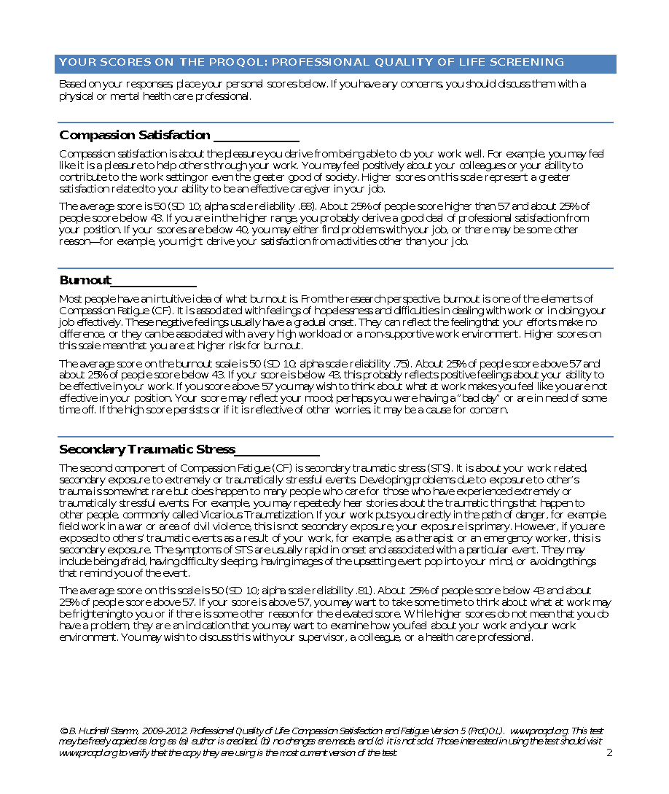
PRO-QOL: PROFESSIONAL QUALITY OF LIFE SCALE
Notes:
Review the Pro-Q
Something that you can use for yourself
As a Supervisor
As a Counselor Educator

Slide 11
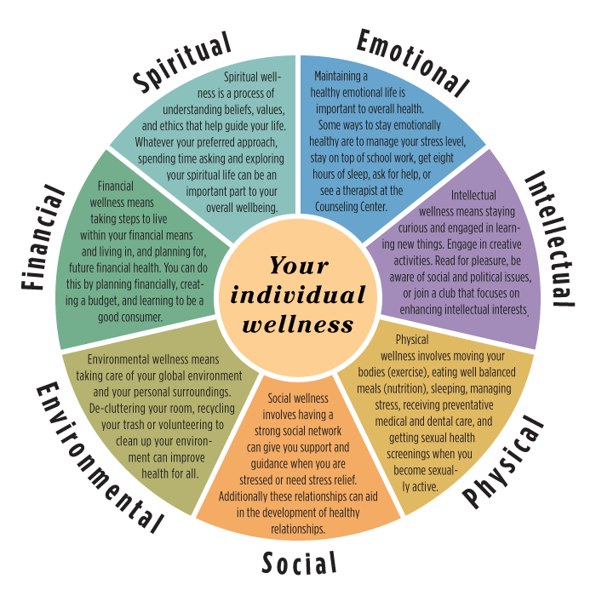
THE WELLNESS WHEEL
Notes:
Review &/or complete Self-Awareness Wellness Assessment
Discuss the various sections of wellness
Identify those areas that may need more focus than others
And finally
Create a Plan
In the plan you will also include areas of connection or social as well as self-care activities

Slide 12
Connections: Social & Professional Support
Identify Your Support Care Network
(3-5 names with phone numbers)
Sharing trauma narratives
Empower to Confront
Telling on Ourselves
Accountability
Notes:
As helping professionals who see colleagues on a regular basis, we need to intentionally utilize that support care network to receive support and to dilute the effects of our work.
The support care network is made up of individuals within our profession, our community, our family, and our friends who we trust and respect. To begin building a support care network, think about and identify three people who you believe can provide you support and sincerely help in times of need.
Sharing Narratives
Empowerment
Accountability
Telling on Ourselves
The four functions of the support care network is to
Share narratives – The power of sharing our stories, both primary and secondary trauma, helps in healing the effects. By sharing the stories, we are able to regulate our experiences to the past so that they stop intruding in our present and impeding our intention. Any experience past or present that causes us discomfort needs to be shared with our support network in order for us to overcome and regulate.
Empower to Confront – Due to our ability of denying and our inability to really see how we are affected by traumatic stress or compassion fatigue; therefore, we need to identify those who we can count on as our support network and empower them to confront us when: (a.) they see us becoming symptomatic and/or (b.) habitually breaching our integrity. This is when they can help us push through our defenses.
Telling on Ourselves – Compassion fatigue can be futile, while we may use avoidance, denial, suppression, and procrastination instead of facing and dealing with our own experiences. By intentionally using our support care network, we are proactively allowing us to have a good, clean feeling that demonstrates that we are maturing as we turn away from our old ineffective coping strategies and towards our own integrity.
Accountability – After “telling on ourselves”, our support network becomes your accountability person as they witness the commitment that you make to yourself to bring your behavior into alignment with your integrity. They can also follow-up with you about your experiences and where you are in managing your compassion fatigue. This person can ensure that you are checking all of legal and professional boxes.

Slide 13
Self-Care & Revitalization
Regular (3xs/week) Physical Exercise
Healthy Diet
Good sleep hygiene
Regular social activities/Quality Family of Friend time
Creative activities or hobbies
Spiritual Practices
Professional Enrichment
Maintaining medical/doctor/dentist visits
Periodic Supervision, Consultation, & Debriefing
Somatic Exercises
https://youtu.be/DsazLj6pt4E
Notes:
Ensure that you are addressing all areas of the wellness wheel when identifying self-care activities
Physical
Psychological
Emotional
Spiritual
Financial
Environmental

Slide 14
Review of Learning Objectives
DEVELOP A CLEAR UNDERSTANDING OF WHAT SIGNS AND SYMPTOMS DEMONSTRATE COMPASSION FATIGUE, VICARIOUS TRAUMA, AND BURNOUT.
EXHIBIT THE ABILITY TO SKILLFULLY ADMINISTER AND INTERPRET COMPASSION FATIGUE ASSESSMENTS, SUCH AS THE PROQOL, AND THE COMPETENCE TO RECOGNIZE KEY RESILIENCY SKILLS FOR THE PREVENTION OF COMPASSION FATIGUE.
CREATE AN EFFECTIVE RESILIENCY PLAN FOR ADDRESSING COMPASSION FATIGUE, BURNOUT, AND VICARIOUS TRAUMA AND DEMONSTRATE THE ABILITY TO IMPLEMENT THESE NEW SKILLS TOWARD PREVENTING COMPASSION FATIGUE.

Slide 15
QUESTIONS???
Notes:
ADDITIONAL RESOURCES WEBSITES
https://www.resiliencyquiz.com/index.shtml
www.myselfcare.org
Self-care quiz, articles
www.compassionfatigue.org
Information for caregivers
www.giftfromwithin.org
Information and articles for post-traumatic stress syndrome survivors and their caregivers

Slide 16
Additional Resources
Professional quality of life information, including compassion fatigue/burnout
www.proqol.org
Princeton Umatter Welllness Wheel Plan Development
https://umatter.princeton.edu/action-matters/caring-yourself/wellness-wheel-assessment
Wellness Wheel Information
https://thriveglobal.com/stories/finding-balance-going-through-it/
Resiliency Self-Quiz
https://www.resiliencyquiz.com/index.shtml
Self-care quiz, articles
www.myselfcare.org
Information for caregivers
www.compassionfatigue.org
Information and articles for post-traumatic stress syndrome survivors and their caregivers
www.giftfromwithin.org
BOOKS
How Can I Help? Stories and Reflections on Service, by Ram Dass and Paul Gorman (Knopf, 1985) 256 pages, $12
The Truth about Burnout: How Organizations Cause Personal Stress and What to Do About It, Christina Maslach and Michael P. Leiter (Jossey- Bass, 1997) 200 pages, $25

Slide 17
Presenter’s Contact Information
Dr. Yulanda Tyre ytyre@liberty.edu
Paige Zeiger valerie.zeiger@waldenu.edu

Slide 18
References
Browning, B. R., McDermott, R. C., & Scaffa, M. E. (2019). Transcendent characteristics as predictors of counselor professional quality of life. Journal of Mental Health Counseling, 41(1), 51-64.
Ellis, T. E., & Patel, A. B. (2012). Client Suicide: What now? Cognitive and Behavioral Practice, 19, 277-287.
Figley, C. R. (2002). Treating compassion fatigue. New York, NY: Routledge.
Figley, C. R. (1995). Compassion fatigue: Coping with secondary traumatic stress disorder in those who treat the traumatized. New York, NY: Routledge.
Gentry, E. (2016). Forward-facing trauma therapy: Healing the Moral Wound. Sarasota, FL: Compassion Unlimited.
Michalchuk, S., & Martin, S. L. (2018). Vicarious resilience and growth in psychologists who work with trauma survivors: An interpretive phenomenological analysis. Professional Psychology: Research and Practice. Advance online publication, doi:10.1037/pro0000212.
Perregrini, M. (2019). Combatting compassion fatigue. Nursing 2019, 49 (2), 51-54.
Sherba, R. T., Linley, J. V., Coxe, K. A., & Gersper, B. E. (2018). Impact of client suicide on social workers and counselors. Social Work in Mental Health, doi:10.1080/15332985.2018.1550028
Teater, M., & Ludgate, J. (2014). Overcoming compassion fatigue: A practical resilience workbook. Eau Claire, WI: PESI.
Van der Merwe, A., & Hunt, X. (2019). Secondary trauma among trauma researchers: Lessons from the field. Psychological Trauma: Theory, Research, Practice, and Policy, 11(1), 10-18.
Whisenhunt, J. L., DuFresne, R. M., Stargell, N. A., Rovnak, A., Zoldan, C. A., & Kress, V. (2017). Supporting counselors after a client suicide: Creative supervision techniques. Journal of Creativity in Mental Health, 12(4), 451-467.

