Slide 1
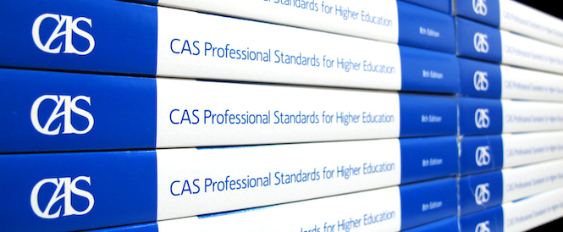
Assessment of Counseling Services:
How Does Counseling Fit Into The Mission Of Student Affairs?
ACCA National Conference
February 29, 2020
Washington, D.C.
Perry C. Francis, Ed.D., LPC Lisa Adams, Ph.D., LPC
Professor of Counseling Interim-Associate Vice President, Student Life
Eastern Michigan University Student Affairs & Enrollment Management
pfrancis@emich.edu University of West Georgia
ladams@westga.edu

Slide 2
How many of you…
Work in a counseling center?
Work in another student affairs area?
Work somewhere else at your institution?
Have looked at the CAS Standards for at least one functional area?
Have participated in a department/program review process using CAS standards?
Have used CAS standards for other purposes?

Slide 3
Official Participant Outcomes
To list and describe the CAS Standards & Guidelines for use in analysis of College Counseling services.
To analyze CAS Standards and functional areas (College Counseling) for use in creating plans for improvement, expansion, or demonstrating efficacy of services.
To use CAS standards to design tools for data collection to discuss and explain impact of services on student body.
To create or develop assessment tools aligned with CAS Standards to create outcome studies for development of strategic goals.

Slide 4
CAS Mission
The Council for the Advancement of Standards in Higher Education (CAS), a consortium of professional associations in higher education, promotes the use of its professional standards for the development, assessment, and improvement of quality student learning, programs, and services.
CAS is a consortium of professional associations who work collaboratively to develop and promulgate standards and guidelines and to encourage self-assessment.

Slide 5
CAS Overview
Based in philosophy of self-assessment
40 member associations
47 sets of functional area standards
  Developing standards that are cross functional (have two or more departments)
Standards of practice informed by wide range of professionals and approved by consensus
Self-assessment guides (SAGs) for program self-study
30+ years of history; span across higher education

Slide 6
Functional Area Standards
Functional Area Standards are defined as "The set of specific standards and guidelines, with the embedded general standards, that apply to one functional area program or service. Often referred to as the CAS Standards for (insert functional area name). As of 2019, there are 45 sets of CAS functional area standards." (CAS, 2019).

Slide 7
CAS Standards
Academic Advising Programs
Alcohol and Other Drug Programs
Assessment Services⁺
Auxiliary Services Functional Areas
Campus Activities Programs⁺
Campus Information and Visitor Services
Campus Police and Public Safety Programs**
Campus Religious, Secular, and Spiritual Programs⁺
Career Services⁺
Case Management Services⁺
Civic Engagement and Service-Learning Programs
Clinical Health Services⁺
College Honor Society Programs
College Unions
Collegiate Recreation Programs⁺
Conference and Event Programs
Counseling Services** (Revised in 2019)
Dining Services Programs⁺
Disability Resources and Services
Education Abroad Programs and Services
Financial Aid Programs
Fraternity and Sorority Advising Programs
Graduate and Professional Student Programs and Services⁺

Slide 8
CAS Standards
Health Promotion Services⁺
Housing and Residential Life Programs
International Student Programs and Services⁺
Internship Programs⁺
Leadership Education and Development**
Learning Assistance Programs⁺
Lesbian, Gay, Bisexual, Transgender, and Queer+ Programs and Services⁺
Master’s Level Higher Education and Student Affairs Professional Preparation Programs**
Multicultural Student Programs and Services⁺
Orientation Programs
Parent and Family Programs⁺
Post-Traditional and Commuter Student Programs and Services⁺
Registrar Services**
Sexual Violence-Related Programs and Services
Student Conduct Programs
Student Media Programs⁺
Sustainability Programs**
Testing Programs and Services⁺
Transfer Student Programs and Services
TRIO and College Access Programs⁺
Undergraduate Admissions Programs and Services
Undergraduate Research Programs⁺
Veterans and Military-Connected Programs and Services⁺
Women's and Gender Programs and Services

Slide 9
CAS Cross Functional Frameworks
Cross-functional Frameworks are defined as "An approach for addressing emerging, evolving, and ongoing issues or topics from a multi- and inter-disciplinary perspective through teams of higher education professionals from different fields or functional areas." (CAS, 2019).
Advancing Health and Well-Being
First-Year Experience
Identifying and Responding to Behavioral Concerns

Slide 10
Uses of CAS Standards
Credibility, Accountability, Improvement
  Program & service improvement
  Measures of quality and effectiveness
  Measures of impact on learning and development
  Design of new programs & services
  Institutional self-studies
  Preparation for accreditation or program review
Staff development
Academic preparation

Slide 11
Standards & Guidelines

Slide 12
12 Component Parts
Mission
Program
Organization & Leadership
Human Resources
Ethics
Law, Policy, & Governance
Diversity, Equity, & Access
Institutional & External Relations
Financial Resources
Technology
Facilities & Equipment
Assessment & Evaluation

Slide 13
General & Specialty Standards
General Standards
Specialty Standards
Common across all functional areas
  For Example:
    Programs & services must develop, disseminate, implement, and regularly review their mission.
Address issues specific to the functional area
  For Example:
    The primary mission of career services is to assist students and other designated clients through all phases of their career development.

Slide 14
Student Learning & Development:
Part of the Program
Programs and services must:
  Assess relevant and desirable student learning and development
  Provide evidence of impact on outcomes
  Articulate contributions to or support of student learning and development in the domains specifically assessed
  Articulate contributions to or support of student persistence and success
  Use evidence gathered through this process to create strategies for improvement of programs and services

Slide 15
Outcome Domains
Knowledge Acquisition, Construction, Integration, and Application
Cognitive Complexity
Intrapersonal Development
Interpersonal Competence
Humanitarianism and Civic Engagement
Practical Competence

Slide 16
Domain Example:
Intrapersonal Development
Dimensions
Realistic self-appraisal, self-understanding, and self-respect
Identity development
Commitment to ethics and integrity
Spiritual awareness
Examples of Learning Outcomes
SELF: Assesses, articulates, and acknowledges personal skills, abilities, and growth areas; uses self-knowledge to make decisions such as those related to career choices; articulates rationale for personal behavior; seeks and considers feedback from others; critiques and subsequently learns from past experiences; employs self-reflection to gain insight; functions without need for constant reassurance from others; balances needs of self with needs of others
IDENTITY: Integrates multiple aspects of identity into a coherent whole; recognizes and exhibits interdependence; recognizes and exhibits interdependence in accordance with cultural and personal values; identifies and commits to important aspects of self
INTEGRITY: Incorporates ethical reasoning into action; explores and articulates the values and principles involved in personal decision- making; acts in congruence with personal values and beliefs; exemplifies dependability, honesty, and trustworthiness; accepts personal accountability
SPIRITUAL: Develops and articulates personal belief system; understands roles of spirituality in personal and group values and behaviors; critiques, compares, and contrasts various belief systems; explores issues of purpose, meaning, and faith

Slide 17
Standards & Outcomes
Standards serve a purpose in leading toward intentional outcomes
CAS identifies 6 learning and developmental outcome domains
Each functional area either directly influences, contributes to, or makes outcome possible
Some outcomes may be more salient to a program/service than others, but all should be on radar
Critically important to think first of desired outcomes & then design programs that will achieve the outcome
Standards, outcomes, assessment lead us to accountability

Slide 18
Sharing Perspectives
With 2-3 other people…
  What are your experiences with using CAS?
  What are the benefits?
  What are the challenges?
  What are your questions?
Report out…

Slide 19
Self-Assessment
The CAS Perspective

Slide 20
Program Evaluation
Is the program or service functioning effectively to achieve its mission?
What evidence is available to support the determination?
How is evidence used to make program decisions?

Slide 21
Student Outcomes Assessment
What is the effect of our work on students?
How are they different as a result of interacting with our programs and services?
How do we know?
How do we demonstrate their learning or development?
What and how do we measure?

Slide 22
Balanced Assessment
Current attention focuses on outcomes
  Shift from industrial economy focusing on inputs, consistency of product
  Shift to the information economy focuses on outcomes, fit of product to consumer (Art Levine)
  Moving to a Service Economy
Important to know both sides:
  Are our programs & services organized and run effectively to achieve the intended outcomes?
  Are the intended outcomes achieved?
  In counseling, are we focused on outcomes for individuals or for our overall program/service?

Slide 23
What if…?
What if we just focused on outcomes?
  If we always achieve the intended outcomes, there’s no problem – we keep doing what we’re doing.
  If we don’t achieve the intended outcomes, and all that we have assessed is those outcomes, how would we decide what to do differently?
If we assess both programs/ services and the actual outcomes, we can make more informed determinations about what needs to be changed or improved.

Slide 24
Where to Start??
Depends on where you are already
Start where you can
Build to a full cycle over time
You Don’t Have To Do It All

Slide 25
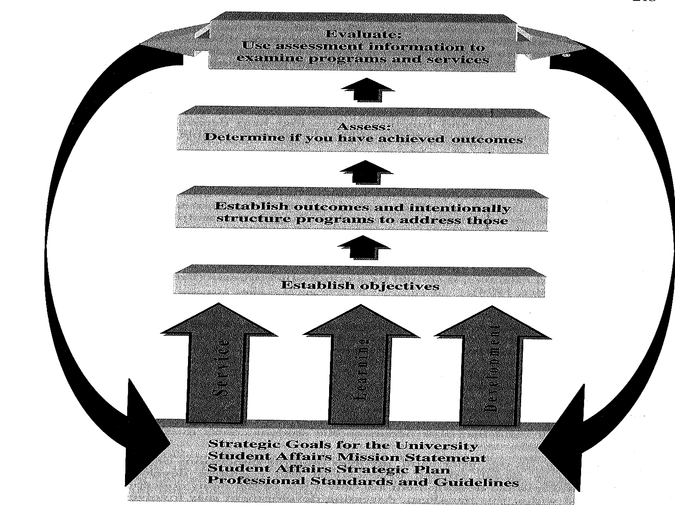
Barham & Scott, 2006

Slide 26
What is the Context?
Institution mission
Institution/division strategic plan
Division/department mission
Professional standards
MAPPING
How do these connect to each other?

Slide 27
Nature of the Unit
Barham & Scott (2006) suggest that we need to consider the nature of the unit:
  Service
  Learning
  Development
How does that inform our work?

Slide 28
Identifying Outcomes
What should be the result of our work?
  Program outcomes
    e.g., % of students reached
  Operational outcomes
    e.g., reduced wait-list time to appointment
  Student outcomes
    e.g., intrapersonal development/integrity/ethical decision-making

Slide 29
Identifying Strategies
What will we do intentionally to try to achieve these outcomes?
  Outreach/programming (active & passive)
  Policies & procedures
  Environmental factors
  Short term & long term

Slide 30
How Will We Know?
Realize that not every outcome needs to be measured, not every outcome can be measured, & not every outcome should be measured
Design intended outcomes & objectives to be assessed so that they are measurable
Decide how to measure them as you are designing the intervention
Carry out your plan & use the results to improve the next cycle

Slide 31
Self-Study Overview
Purpose & scope of study is defined (do all or just some…)
Self-study team is identified & trained (does not have to be CC staff)
Evaluative evidence is collected and reviewed
Self-study is conducted; ratings are compiled
Discrepancies are identified
Appropriate actions are determined
Special actions for program enhancement are recommended
Action plan is developed and communicated

Slide 32
Summary
CAS is all about professionals coming together to promote…
Standards and guidelines to design quality programs & services
Targeted learning and developmental outcomes
Self-assessment of both programs/services and student outcomes

Slide 33
Developing Your Plan
Institution/division context?
  What is most relevant & important?
Your unit
  What is the primary purpose/overall objective?
  What intended outcomes are in place?
  What documentation do you have?
  How do you use it?
  What have you changed?

Slide 34
Developing Your Plan
History
  What kind of program review has been conducted?
Context for Review
  Is there an institutional expectation or system of program review?
Timing
  Where are you on the accreditation cycle?

Slide 35
Developing Your Plan
What is your area of greatest need?
  Comprehensive assessment plan
  Program evaluation
  Establishment of intended outcomes
  Intentional program development
  Measuring actual outcomes
  Use of assessment results
  Other?

Slide 36
A Few Final Thoughts
Don’t ignore the reality & usefulness of retrospective sense-making
Even if you have not been engaged in assessment formally, you have probably been using the principles in your work
Figure out how what you have been doing fits with what you want to be doing, and then fill in the rest of the plan
Just start…

Slide 37
Council for the Advancement of Standards in Higher Education
www.cas.edu
One Dupont Circle NW, Suite 300
Washington, DC 20036
Lisa Adams, Ph.D., LPC Perry C. Francis, Ed.D., LPC
Interim-Associate Vice President, Student Life Professor of Counseling
Student Affairs & Enrollment Management Eastern Michigan University
University of West Georgia pfrancis@emich.edu
ladams@westga.edu
ACCA REPRESENTATIVE TO CAS

