Slide 1
Identity Privilege and Being an Effective Ally
Matthew Cullen, LICSW, M.ED.
Green River College – Auburn, WA

Slide 2
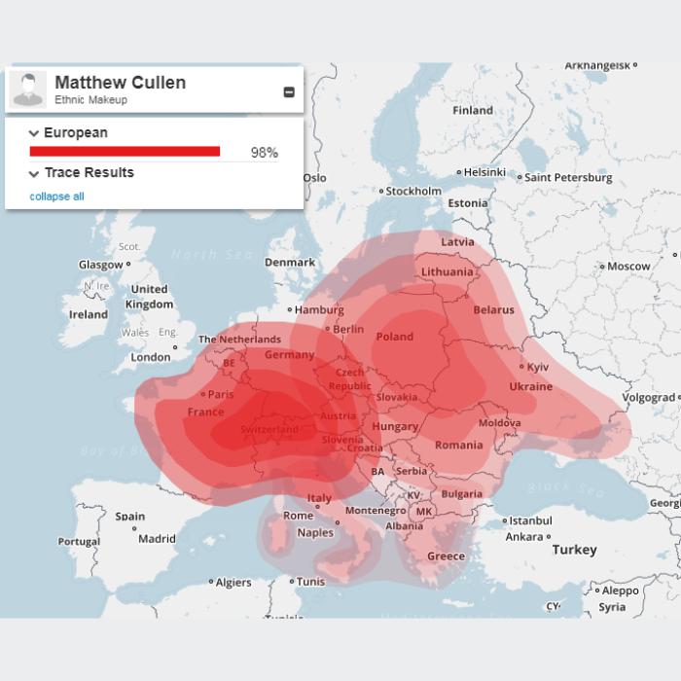
Introduction
My Identity
White
Cisgender male
Straight
Christian
See, hear, and move w/o assistive devices
Lower Middle Class family

Slide 3
My Wife’s Ancestral Origins

Slide 4
Recgonition
Peggy McIntosh
Sherry Arnsetin
Sian Ferguson
Cody Charles
Jamie Utt
Instructors
Colleagues
Students
Loved Ones

Slide 5
Learning Objectives
Define ”Identity Privilege”
Describe your own privilege
Apply strategies & create steps for closing equity gap on your campus
Identify resources for doing Ally work for and with various groups

Slide 6
Identity Privilege
"A right or immunity…”¹
Afforded to those of the ”Majority”
“…is like an invisible weightless knapsack…”²
Autonomy & power
Favorable policies & programs
Being able to participate and affect change
Catered daily comforts
Immunity aka “Ignorance”
“Like a fish in water”³

Slide 7
Arguing Against Privilege

Slide 8
What to Know about Privilege⁴
The other side of oppression
Understood in the context of power systems
Privilege & oppression affect but don’t negate each other
What everyone should experience
Doesn’t mean you didn’t work hard

Slide 9
Checking Your Privilege
Why do we need to?
Effectively serve students (MSJCC)
Individually
On our campuses
In our communities

Slide 10
Privilege Walk

Slide 11
Privileged and Marginalized Groups
5

Slide 12
Who are you?
What part(s) of your identity are you acutely aware of?
Especially during your interactions with:
Family
Friends
Your neighbors
Colleagues
Students
Which parts are you not as attuned to with these groups?

Slide 13
What exactly is an “Ally?”

Slide 14
Common Missteps⁶
Marginalizing someone’s experience
Choosing not to speak
Not taking responsibility for our errors
Not doing our own research
Seeing ourselves as either good or bad
Doing change initiatives on our own
Relying on one person for your info
Crying
Giving Advice
Relying on kindness

Slide 15
10 Things ”Allies” Need to Remember⁷
Being an Ally is about listening
Allyship vs. Ally
Earned identity, not chosen
A way of being
Education is necessary and vital
Ally work is not a solitary act
Be a support, not the voice
Focus on those like us
We will fail – accept it and move on
Do not monopolize emotional energy

Slide 16
Counselors in Allyship
In a professional sense, what can we do?
Three-pronged approach
Individual
Center-wide
College and campus community-wide
Participation Ladder

Slide 17
Participation Ladder⁸

Slide 18
Difference in Participation

Slide 19
One-on-one Counseling
Use non-assumptive language
Learn about the student’s identity group
Be upfront about identity privilege areas
Office “decoration”
Empower and advocate for students in issues dealing with oppression

Slide 20
Evolving Terminology
Hispanic
Latino
Latino/a
Latin@
Latinx
Latine

Slide 21
One-on-one Counseling
Use non-assumptive language
Learn about the student’s identity group
Be upfront about identity privilege areas
Office “decoration”
Empower and advocate for students in issues dealing with oppression

Slide 22
Friday’s Keynote Dr. Dixon-Saxon
Validate feelings
Connect with resources
Empower and advocate for students in issues dealing with oppression

Slide 23
Counseling
Professional development
Inclusive policies
Language
Signage
Center Demographics
Awareness campaigns and programming
Connecting with community resources
Learn about our colleagues’ identities

Slide 24
College and Campus Community
Inclusive policies
Resources
Celebration and Affirmation
Programs to address resource and achievement gaps
Representative Personnel

Slide 25
Learn about Allyship
Human Rights Campaign Ally Guide
Racial Equity Tools – Guidelines for Being Strong White Allies
Brown University's Student & Employee Accessibility Services
How to Be an Ally: 23 Resources That Can Help

Slide 26
Gain Insight
Media
A Girl Like Me: The Gwen Araujo Story
Prayers for Bobby
Alex Sanchez’s Rainbow Trilogy Book Series
$2.00 a Day: Living on Almost Nothing in America by Edin & Schaefer
Morgan Spurlock’s 30 Days
People
Trevor Noah
Tim Wise
Colleagues, loved ones, students

Slide 27
Research on Your Own
By topic
For resources
“Current issues facing…”
“Types of privilege…”
“Important terms relating to…”

Slide 28
Material Sources
Definition of “Privilege” from Merriam Webster Dictionary - https://www.merriam-webster.com/dictionary/privilege
“Unpacking the Invisible Knapsack” – from Peggy McIntosh - https://www.racialequitytools.org/resourcefiles/mcintosh.pdf
“Fish out of water” – Pennsylvania State University - https://edge.psu.edu/workshops/mc/power/page_01.shtml
“What To Know About Privilege” – Sian Ferguson - https://everydayfeminism.cSian om/2014/09/what-is-privilege/
“Big 8” picture – Paul Gordon Brown - https://www.slideshare.net/paulgordonbrown/social-justice-social-good-social-media-social-change/19-Privileged_and_Marginalized_GroupsNationalityGenderRaceReligionSexualOrientationClassAblenessAgeOthersBIG_8
“Common Missteps” – Cody Charles - https://everydayfeminism.com/2015/10/counterproductive-allyship/
“10 Things ‘Allies’ Need to Remember” – Jamie Utt - https://everydayfeminism.com/2013/11/things-allies-need-to-know/
“Participation Ladder” – Sherry Arnstein – picture from: https://nhspublicvoice.wordpress.com/2016/10/27/ladder-of-participation-shows-how-involved-you-are/
Opening activity – Nathan W. Pyle - https://www.buzzfeed.com/nathanwpyle/this-teacher-taught-his-class-a-powerful-lesson-about-privil
Privilege Walk Questions - https://www.uh.edu/cdi/diversity_education/resources/activities/pdf/privilege-walk.pdf
Ratts, M. J. (2017). Charting the Center and the Margins: Addressing Identity, Marginalization, and Privilege in Counseling. Journal of Mental Health Counseling, 39(2), 87–103. https://doi.org/10.17744/mehc.39.2.01

Slide 29
References
Combs, G. (2019). White Privilege: What’s a Family Therapist To Do? Journal of Marital & Family Therapy, 45(1), 61–75. https://doi.org/10.1111/jmft.12330
Ratts, M. J. (2017). Charting the Center and the Margins: Addressing Identity, Marginalization, and Privilege in Counseling. Journal of Mental Health Counseling, 39(2), 87–103. https://doi.org/10.17744/mehc.39.2.01

