Slide 1
Developing a Telemental Health Services Program
ETHICS, PRACTICE, IMPLEMENTATION
Nicholas Joyce, PhD and Scott Strader, PhD

Slide 2
LEARNING OBJECTIVES

Slide 3
1.
Participants will
2.
Participants will
3.
Participants will
discuss the ethical and legal issues associated with telemental health practice.
discuss the reasonable standards of care related to telemental health practice, including informed consent and risk assessment
identify individuals who are most likely to benefit from telemental health services.

Slide 4
4. Participants will identify unique aspects of working in an online space that differ from face-to-face settings

Slide 5
Today’s Session
1. Discuss History and Current state of Telehealth in Therapy
2. Explore unique aspects and outcomes of online therapy
3. Discuss relevant ethical and legal issues
4. Describe the process for creating a telehealth program at USF

Slide 6
History and Current State of Affairs

Slide 7
HISTORY
Distance therapy since Freud
TBH developed since 1959
Cecil Wittson opened tele-education in telepsychiatry program at the Nebraska Psychiatric Institute, thereby launching the first known physician to patient contact in real time (Wittson & Benschoter, 1972)
Myriad of telephone, online, and text options

Slide 8
It’s happening
The global telehealth market is projected to increase at an annual compounded rate of 30 percent between 2017 and 2022, achieving an estimated value of $12.1 billion.
The majority of higher income and privately insured consumers indicate a preference for telehealth.
Surveys consistently show that more than 70 percent of consumers would consider a virtual health service.

Slide 9
46%
67%
40%
According to the 2014 Analytics Telemedicine Survey conducted by the Healthcare Information and Management Systems Society (HiMSS):
of health system respondents currently offer telemedicine
of the rest are investigating telemedicine
are using it to fill gaps in patient care
23%
Use it to offer care not otherwise available

Slide 10
It’s happening
We are more scared than the consumer
How you do telemental behavioral health makes the difference

Slide 11
AUCCD Survey 2018 Do you offer any form of telehealth?
2012: 0.3%
2018: 59.2%
Most use for screening
25% use it for therapy as well

Slide 12
Application of Services

Slide 13
Barriers
The following barriers to using the technologies also exist:
Costs
History of limited reimbursement
Limits to licensure across state lines and international borders
Restrictive regulations for credentialing in hospital settings
Attitudes of practitioners

Slide 14
Barriers continued
The following barriers to using the technologies also exist:
Lack of clear ethical guidelines from larger professional associations
Perception of behavioral health control and ease and utility of technology
Decreased awareness of professionals
Lack of specific research
Ambiguity about malpractice insurance coverage

Slide 15
Who would be best served by TBH
Technologies have the potential to reach people because of the five main benefits they provide (Five A's):
Accessibility
Affordability
Anonymity
Acceptability
Adaptability

Slide 16
Who can this serve in college?
Distance students
Stigmatized students
Students with transportation difficulties

Slide 17
Appropriateness for TBH
DISCUS (Barnett-Levy et al., 2010)
Duration – how long has the client been suffering? (e.g., The longer the duration of the symptoms and conditions, the higher likelihood that the client will be better served with onsite, in-person treatments)
Interpersonal History – is there a history of positive interpersonal relationships and benefit from counseling services or other services that require interpersonal engagement?
Severity – more severe conditions are likely better served by in-person services
Complexity – more complex and complicated conditions are also better served by in-person services
Understanding – is the client able to understand information provided to them, understand the benefits and risks of both in-person and tele-mental health services?
Social Support – is adequate social support available to the client outside of treatment?

Slide 18
We are already doing it (Barnett & Kolmes, 2016)
Phone or email being used for crisis
Apps to track client progress (TAO)
Consultation from experts via video conference or phone
Individuals who reside in rural, remote, or isolated areas with limited or no treatment providers
Individuals who are homebound due to disability, lack of transportation, or symptoms such as agoraphobia or a fear of driving
Discomfort with mental health services or embarrassment over symptoms prefer relative anonymity of receiving services over the telephone or the Internet
During inclement weather when the client and/or practitioner are not able to safely get to the practitioner’s office for regularly scheduled in-person treatment

Slide 19
Unique aspects of Telehealth services and Outcomes

Slide 20
Psychological Aspects of Cyberspace
Synchronous vs Asynchronous communication (Suler, 2008)
Online disinhibition effect (Suler, 2004)
Loosening of social restrictions and inhibition that are present in f2f interaction
Invisibility
Asynchornicity
Solipsistic introjection
Dissociative imagination
Minimization of power

Slide 21
Meta Analysis
Barak et al. (2008)
64 articles reporting 92 different studies involving 11,922 participants
Medium effect size for online interventions
No differences in effect sizes whether delivered through a website or in etherapy version through email or chat or other modalities
Studies that directly compared the online modality to a face-to-face modality, there was no difference between these two modalities
Audio (ES = .91), email (ES = .51), and chat (ES = .53) modalities had larger effects than webcam (ES = .31)
Authors argued that, “Internet-based therapy, on the average, is as effective, or nearly as efficacious, as face-to-face therapy” (p.141)

Slide 22
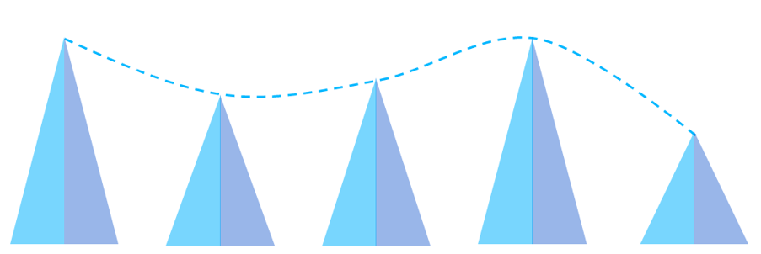
VA Study
Godleski, L. Darkins, A. & Peters, J. (2012)
In a 2012 report of efficacy research involving 98,609 patients at the Veteran's Administration, the researchers concluded that telemental health is not only effective, but it can also surpass the efficacy of in-person encounters when delivered by a wide variety of behavioral health professionals for a range of commonly treated behavioral health disorders.
98,609 patients: remote clinical videoconferencing and digital services.
Between 2006 and 2010, psychiatric admissions of telemental health patients decreased by an average of 24.2% (annual range 16.3%-38.7%), and the patients' days of hospitalization decreased by an average of 26.6% (annual range 16.5%-43.5%). The number of admissions and the days of hospitalization decreased for both men and women and in 83.3% of the age groups.

Slide 23
Study: College Students
(Haas et al., 2008)
Internet has been used on college campuses to reach students who might normally go without treatment
Sent an email with a screening questionnaire to assess depression and suicidality at one private and one state university
Computer scored results and placed students into tiers
Students could schedule an in-person evaluation or have an anonymous online dialogue with the counselor
Emails to 14,500 undergraduate students, and 1,162 completed questionnaires (8% response rate)

Slide 24
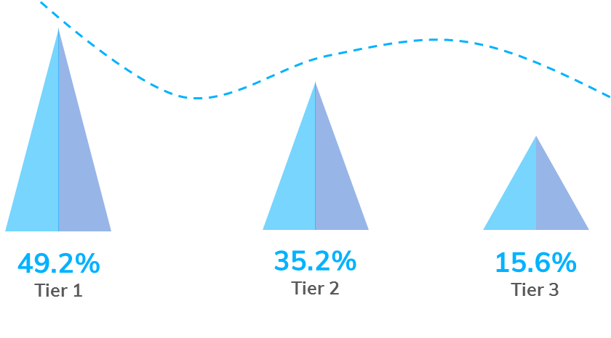
Results: College Students
(Haas et al., 2008)
Reponses placed respondents into: Tier 1 (49.2%),
Tier 2 (35.2%), and Tier 3 (15.6%).
Only 13.6% of Tier 1 and 2 students were
currently in psychotherapy
(88.9%) viewed feedback. Twenty-four percent of students engaged in one or more online dialogues, average being 2.4 dialogues.
190 saw a counselor for an in-person evaluation. Significantly more likely to come in for an in-person evaluation if they had an online dialogue
Counselors who evaluated the in-person students said at least three-fourths of them would not have sought help without this intervention.

Slide 25
CASE
Jill is a 23 year old heterosexual white female from a low SES background. She lives in the second bedroom of a 2 bedroom home that is owned by a family member. She is her final semester, taking 3 classes. Due to family problems, which have caused a parent and sibling to move into the living room of the home, she has decided to drop 2 of the classes and get a job to pursue living on her own. These problems have also exacerbated her anxiety and depression. She commutes by city bus 2 hours each way to attend college. She is now only on campus Tuesday nights after 4, limiting when she can be seen.
Is telemental health appropriate for this client? If so, what issues would need to be addressed or considered?

Slide 26
Ethical and Legal Issues

Slide 27
Ethical and Legal Issues
Licensure Portability
Potential Legal Pitfalls
Emergencies and Crises
Annoying Technologies
Informed Consent

Slide 28
Licensure Portability
Clinician’s license must be active in the state where the client sits
Not concerned with where clinician sits
Psychology Interjurisdictional Compact (PSYPACT)
Approved/Endorsed by ASPPB
“Interstate compact” allowing for telehealth and temporary in-person, face-to-face practice of psychology across jurisdictional boundaries
Applies only to licensed psychologists

Slide 29
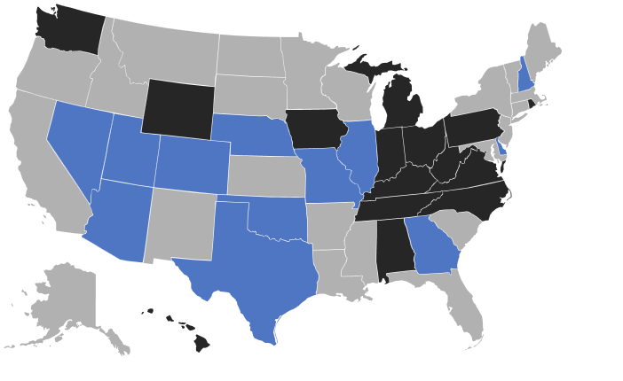
PsyPact Current Status

Slide 30
Potential Legal Pitfalls
Limited case law
Privacy/HIPAA compliance

Slide 31
Dealing with Crises/Emergencies
Important to determine location of client
Advance discussion of actions the clinician will take
Steps
Thorough risk assessment including symptom checklist (e.g., BHM, CCAPS)
Responsible individual nearby and available
Local agency equipped to respond quickly to crises (e.g., mobile crisis unit)
Local law enforcement/911
Follow-up and redetermination of appropriateness for telehealth

Slide 32
Informed Consent
Contains several important elements to address above concerns
Determination of appropriateness for telehealth
Understanding of risks and benefits
Equipment, privacy, hacking
Located in Florida, in a private setting
Response to emergencies
Periodic re-evaluation of appropriateness for telehealth

Slide 33
Example consent
I understand that certain situations, including emergencies and crises, are inappropriate for video/computer-based psychological counseling services. If my counselor is concerned about me, loses contact with me, or if I fail to show for a scheduled tele-mental health session, I understand that my counselor will attempt to contact me to check on my wellbeing.
Additionally, if I am showing signs of being in serious distress, I grant Dr. Joyce permission to contact me by phone or email.
If I show indicators that I may be in real trouble, including at serious risk for self-harm or harm to others, I grant Dr. Joyce permission to contact someone to insure my safety. Dr. Joyce may contact:
A close personal contact such as a parent or spouse
Personal contact:
Name Phone
An office or agency that performs crisis well-being checks in my community (such as a 24-hour crisis service or the police department)
Crisis Response:
Agency Name Phone
Local law enforcement/police, if different from above
Police/law enforcement:
County/city/jurisdiction Phone Number

Slide 34
Annoying Technologies
Client’s equipment
Technology bound to fail
Back-up plan
Redetermination of appropriateness for telehealth

Slide 35
CASE
John is a 22 year old, Latino, heterosexual male. He is a senior in accounting. J moved two hours away at the beginning of this semester due to housing costs and family issues. He is taking 4 online classes to finish his degree this term. He is coming on intake today (BHM red on red) due to increased distress over the end of his 2 year romantic relationship when he discovered his ex was cheating on him and then ended the relationship. J reports he had heard the CC does online therapy now and wants to seek those services.
What issues would you attend to in this case?

Slide 36
Creating a program at
USF

Slide 37
Step 1 Needs Assessment
Is there a need for this service on campus?
HEMHA Guide
Increase in distance programming
Health programs moving downtown

Slide 38
Step 2 Workgroup
Identify staff with interest in this area
Identify what areas need to be researched

Slide 39
Step 3: Review relevant documents and information
APA guidelines for telepsychology
HEMHA distance learning guide
TAO training modules
State practice guidelines
Relevant research
Consulted with state institutions already moving in this direction (e.g., FIU, UF)

Slide 40
Step 4 Decide elements to include for implementation of telemental health
Informed consent
Risk
Legal and ethical concerns
Appropriate equipment and platform
Training/certification

Slide 41
Step 5 Develop draft procedure for implementation and practice, and first draft of informed consent
Discussed with leadership team
Consulted with Office of General Counsel
Telemental health workgoup approves draft with appropriate revisions to implementation plan

Slide 42
Step 6: Get Trained!
Contracted with Telebehavioral Health Institute for Level I & Level II training and follow-up consultations (8 level I certifications and 2 level II certifications for a staff of 25 senior staff)
Only full-time senior staff were eligible, no part-time and no trainees
Two clinicians to serve as leads – both completed Level I and Level II training
Discussed in staff meeting and get volunteers to serve as a pilot group (complete Level I)

Slide 43
More training
3-hour CEU to all staff on background and practice of telemental health
Solicited input to incorporate into revised procedure and informed consent

Slide 44
Step 7
Follow-up in staff meeting to present final procedure
Certified staff began providing Telebehavioral health services to students/clients

Slide 45
Current situation
Completing Pilot project
Compiling data on use
Working with University Marketing and Communications on branding and marketing materials to roll out once pilot is finished.

Slide 47
QUESTIONS?
Nicholas Joyce: joycen@usf.edu
Scott Strader: scottstrader@usf.edu
www.drnickjoyce.com

Slide 48
Creating a Tech Based Practice

Slide 49
Six Fundamental Questions
What clients/patients do you wish to serve?
What type of care do you wish to deliver?
Where will you be and where will your clients/patients be?
When will you connect with clients and patients?
How will you find new patients and how will you get paid?
Which technology vendor(s) will you use?

Slide 50
Videoconferencing Pros and Cons
Warm in person vs cold tech encounters
Nilssen survey of selecting a videoconferencing, ease of use was ranked as number one.
The keys to successful videoconferencing are:
Selecting adequate technologies
Making them available and convenient
The clinicians know how to use them.
The client/patient know how to use them
Applying good communication skills

Slide 51
Social Networking
Research shows some professionals lose sight of their legal and ethical limits when engaging with such sites.
One hundred forty-four tweets (3%) were categorized as unprofessional. Thirty-eight tweets (0.7%) represented potential patient privacy violations, 33 (0.6%) contained profanity, 14 (0.3%) included sexually explicit material, and 4 (0.1%) included discriminatory statements.
(Cretien et al, 2010)

Slide 52
Efficacy and Results

Slide 53
RCT Study
Griffiths and Christensen (2006)
Griffiths and Christensen (2006) 15 RCTs of online self help
Results:
Thirteen
had least one positive outcome

Slide 54
Additional Studies
Backhaus et al (2012) lit review showed videoconferencing psychotherapy is feasible, it has been used in a variety of therapeutic formats and with diverse populations, is generally associated with good user satisfaction, and has similar clinical outcomes of traditional psychotherapy
Hilty et al (2013) meta analysis concluded that telebehavioral health is effective and increases access to care
ATA Guidelines (2013) indicated no studies have identified any patient subgroup that does not benefit from or is harmed by, mental health care provided through remote videoconferencing. Recent large randomized controlled trials demonstrate the effectiveness of telemental with many smaller trials also supporting this conclusion.

Slide 55
Research on the Therapeutic Relationship
The heart of common factors approaches is the importance of the working alliance (Duncan, Miller, Wampold, & Hubble, 2010).
Day and Schneider (2002) randomized 91 clients into face-to-face, audio, and videoconferencing conditions of 5 sessions CBT therapy.
Working Alliance Vanderbilt Psychotherapy Process Scale
Audio (M = 4.15) and video (M = 4.19) conditions had more client participation than did the face-to-face condition (M = 3.99).
Prado and Meyer (2004) Brazil online WAI scores similar to f2f
Cook and Doyle (2002) compared online clients’ WAI scores to validation sample. Online had higher Bond and Composite score, no differences in Bond

Slide 56
Small Group Work

Slide 57
Questions?

Slide 58
INSTRUCTIONS FOR USE
EDIT IN GOOGLE SLIDES
Click on the button under the presentation preview that says "Use as Google Slides Theme".
You will get a copy of this document on your Google Drive and will be able to edit, add or delete slides.
You have to be signed in to your Google account.
EDIT IN POWERPOINT®
Click on the button under the presentation preview that says "Download as PowerPoint template". You will get a .pptx file that you can edit in PowerPoint.
Remember to download and install the fonts used in this presentation (you’ll find the links to the font files needed in the Presentation design slide)
More info on how to use this template at www.slidescarnival.com/help-use-presentation-template
This template is free to use under Creative Commons Attribution license. You can keep the Credits slide or mention SlidesCarnival and other resources used in a slide footer.

Slide 59
Hello!
I am Jayden Smith
I am here because I love to give presentations.
You can find me at:
@username

Slide 61
THIS IS A SLIDE TITLE
Here you have a list of items
And some text
But remember not to overload your slides with content
Your audience will listen to you or read the content, but won’t do both.

Slide 62
YOU CAN ALSO SPLIT YOUR CONTENT
Black
Is the color of coal, ebony, and of outer space. It is the darkest color, the result of the absence of or complete absorption of light.
White
Is the color of milk and fresh snow, the color produced by the combination of all the colors of the visible spectrum.

Slide 63
IN TWO OR THREE COLUMNS
Yellow
Is the color of gold, butter and ripe lemons. In the spectrum of visible light, yellow is found between green and orange.
Blue
Is the colour of the clear sky and the deep sea. It is located between violet and green on the optical spectrum.
Red
Is the color of blood, and because of this it has historically been associated with sacrifice, danger and courage.

Slide 64
A PICTURE IS WORTH A THOUSAND WORDS
A complex idea can be conveyed with just a single still image, namely making it possible to absorb large amounts of data quickly.

Slide 65
Want big impact?
USE BIG IMAGE

Slide 66
USE CHARTS TO EXPLAIN YOUR IDEAS
White
Gray
Black

Slide 67
USE INFOGRAPHICS TO SHOW DATA
87%
Enter text here.
50%
Enter text here.
55%
Enter text here.
88%
Enter text here.
30%
Enter text here.
Diagram featured by http://slidemodel.com

Slide 68
OR DIAGRAMS TO EXPLAIN COMPLEX IDEAS
Insert your desired
text here.
Insert your desired
text here.
Insert your desired
text here.
Insert your desired
text here.
Insert your desired
text here.
Diagram featured by http://slidemodel.com

Slide 69
AND TABLES TO COMPARE DATA
 | A | B | C
Yellow | 10 | 20 | 7
Blue | 30 | 15 | 10
Orange | 5 | 24 | 16

Slide 70
MAPS

Slide 71
89,526,124
Whoa! That’s a big number, aren’t you proud?

Slide 72
89,526,124$
185,244 users
100%
That’s a lot of money
And a lot of users
Total success!

Slide 73
OUR PROCESS IS EASY
first
second
last

Slide 74
LET’S REVIEW SOME CONCEPTS
Yellow
Is the color of gold, butter and ripe lemons. In the spectrum of visible light, yellow is found between green and orange.
Blue
Is the colour of the clear sky and the deep sea. It is located between violet and green on the optical spectrum.
Red
Is the color of blood, and because of this it has historically been associated with sacrifice, danger and courage.
Yellow
Is the color of gold, butter and ripe lemons. In the spectrum of visible light, yellow is found between green and orange.
Blue
Is the colour of the clear sky and the deep sea. It is located between violet and green on the optical spectrum.
Red
Is the color of blood, and because of this it has historically been associated with sacrifice, danger and courage.

Slide 75
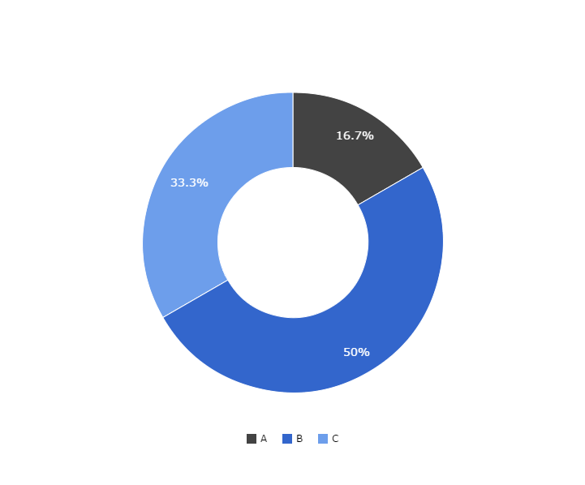
You can copy&paste graphs from Google Sheets

Slide 76
ANDROID PROJECT
Show and explain your web, app or software projects using these gadget templates.
Place your screenshot here

Slide 77
iPHONE PROJECT
Show and explain your web, app or software projects using these gadget templates.
Place your screenshot here

Slide 78
TABLET PROJECT
Show and explain your web, app or software projects using these gadget templates.
Place your screenshot here

Slide 79
DESKTOP PROJECT
Show and explain your web, app or software projects using these gadget templates.
Place your screenshot here

Slide 80
Thanks!
Any questions?
You can find me at:
@username
user@mail.me

Slide 81
CREDITS
Special thanks to all the people who made and released these awesome resources for free:
Presentation template by SlidesCarnival
Photographs by Death to the Stock Photo (license)

Slide 82
Presentation design
This presentations uses the following typographies and colors:
Titles & body copy: Muli
You can download the font on this page:
https://www.fontsquirrel.com/fonts/muli
White #FFFFFF
Blue #00B2FF
You don’t need to keep this slide in your presentation. It’s only here to serve you as a design guide if you need to create new slides or download the fonts to edit the presentation in PowerPoint®

Slide 83
SlidesCarnival icons are editable shapes.
This means that you can:
Resize them without losing quality.
Change line color, width and style.
Isn’t that nice? :)
Examples:

Slide 84
😉
Now you can use any emoji as an icon!
And of course it resizes without losing quality and you can change the color.
How? Follow Google instructions https://twitter.com/googledocs/status/730087240156643328
✋👆👉👍👤👦👧👨👩👪💃🏃💑❤😂😉😋😒😭👶😸🐟🍒🍔💣📌📖🔨🎃🎈🎨🏈🏰🌏🔌🔑 and many more...

